Slide 1
Probabilistic programming Day 2
Sampling - Markov chains – MonteCarlo – Metropolis – Bootstrap - BayesianRegression – Classification - More PyMC3

Slide 2
Recap
Third way between ML (big data, black box) and Stats (Hypothesis and tests)
Probabilistic programming = Bayes + Sampling

Slide 3
Sampling
why? how?

Slide 4
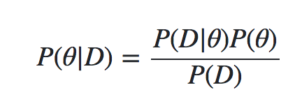
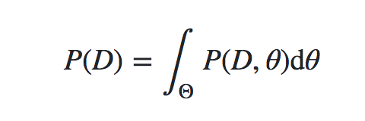
Why sampling
Conjugate priors do not scale
Hierarchical models have hundreds of parameters
=> impossible to derive closed form solution
approximate the posterior distribution
Bayes formula requires to integrate over space of all parameters to estimate the denominator
=> curse of dimensionnality

Slide 5
Sampling – an overview
approximation of any high dimensional integral.
Family of algorithms
Metropolis
Metropolis-Hastings, the Gibbs Sampler, Hamiltonian MCMC and the No-U-Turn Sampler (NUTS)
Monte Carlo: Random search
Markov chains: jumping around without dependence on starting point

Slide 6
A Short History of Markov Chain Monte Carlo
1953
Timeline
see Probabilistic programming in Python using PyMC3.pdf for timeline of probabilistic programming
see A Short History of Markov Chain MonteCarlo 2011 0808.2902.pdf
A Short History of Markov Chain MonteCarlo 2011 0808.2902.pdf

Slide 7
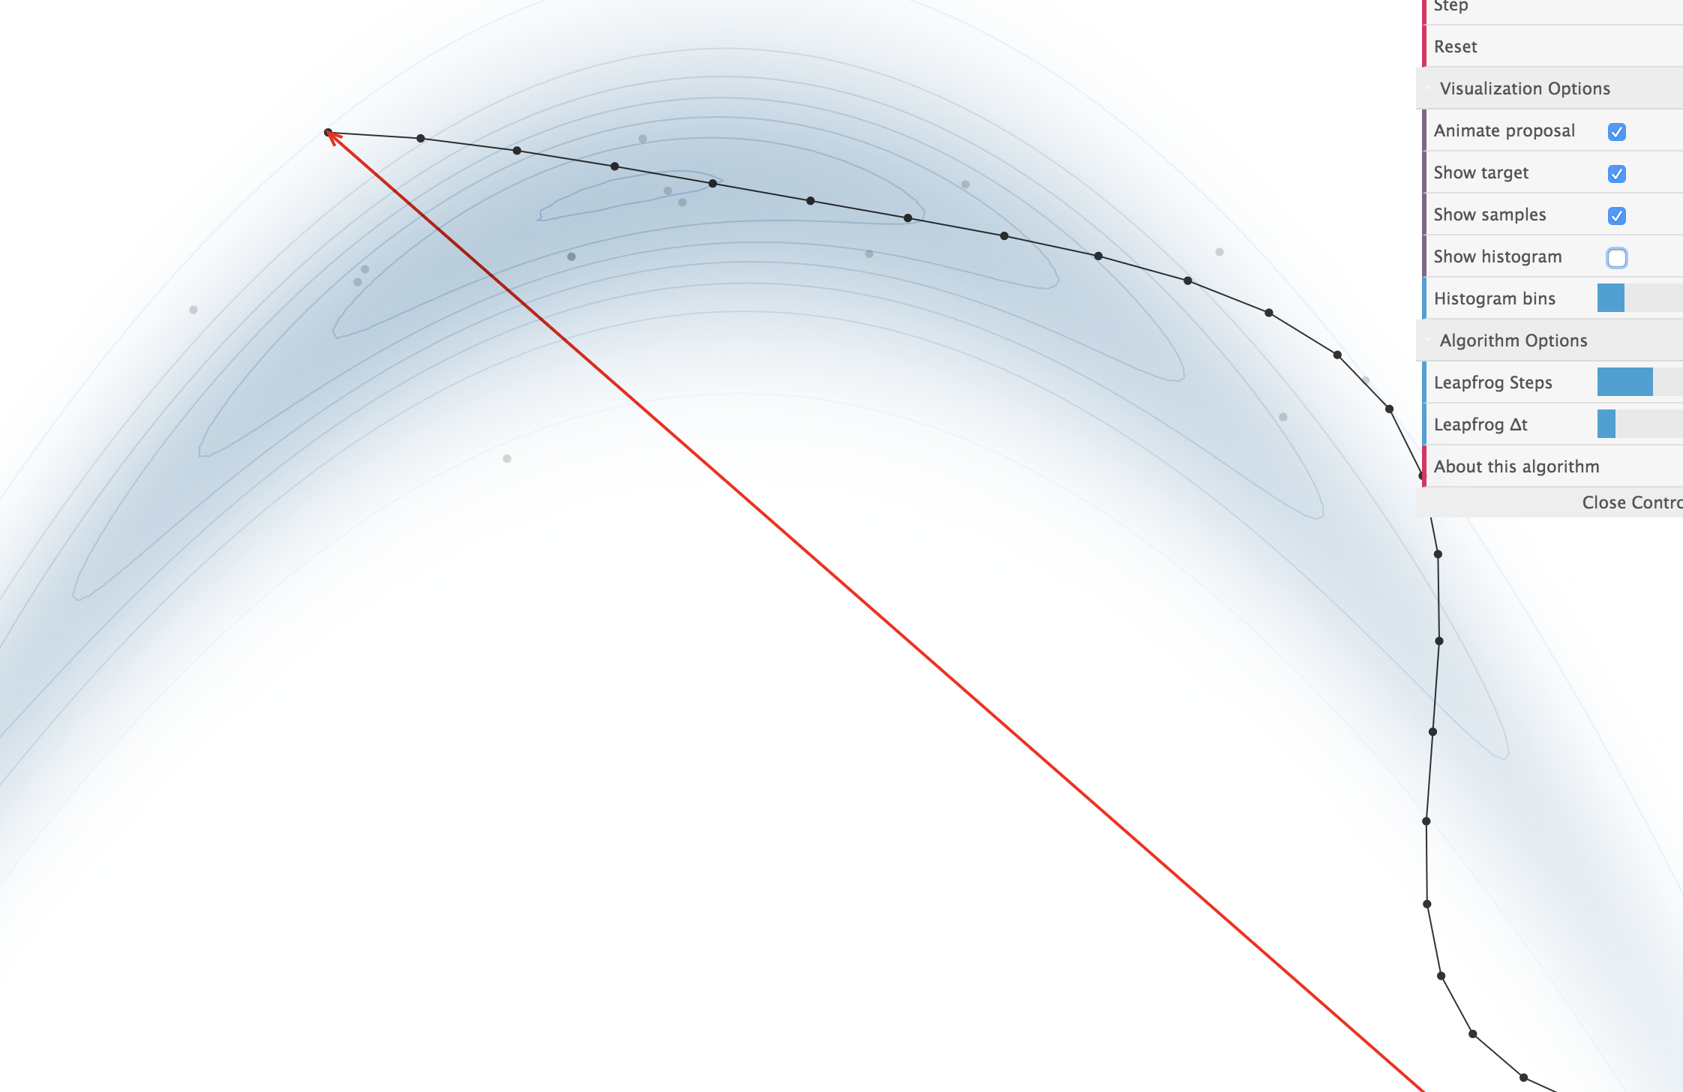
Sampling demo
https://chi-feng.github.io/mcmc-demo/

Slide 8
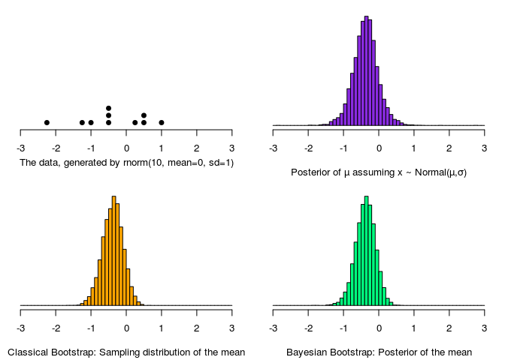
Distribution by sampling: Bootstrap!
From a small number of samples, sample with replacement to obtain the distribution of the random variable
Powerful stuff!
Notes:
Faire un exemple notebook

Slide 9
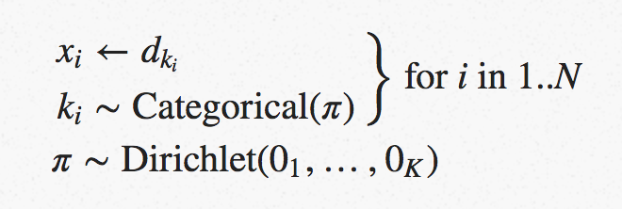
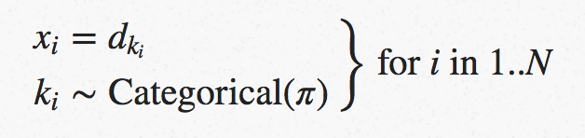
The Non-parametric Bootstrap as a Bayesian Model
Boostrapping as a simplified version of MCMC (in a way)
http://www.sumsar.net/blog/2015/04/the-non-parametric-bootstrap-as-a-bayesian-model/

Slide 10
Demo coin flip
Dataset of coin flips
bootstrap
compare pyMC3
should have same distribution stats?

Slide 11
MCMC
Monte Carlo + Markov Chain

Slide 12
approximate the posterior distribution
sample from the posterior distribution by combining a "random search" (the Monte Carlo aspect) with a mechanism
for intelligently "jumping" around, but in a manner that ultimately doesn't depend on where we started
from (the Markov Chain aspect).
Hence Markov Chain Monte Carlo methods are memoryless searches performed with intelligent jumps.
numerically evaluate an integral in a potentially very large dimensional space

Slide 13

Markov Chain Monte Carlo is a family of algorithms
Metropolis – Hastings Algorithm.
see also the Gibbs Sampler, Hamiltonian MCMC and the No-U-Turn Sampler (NUTS).

Slide 14
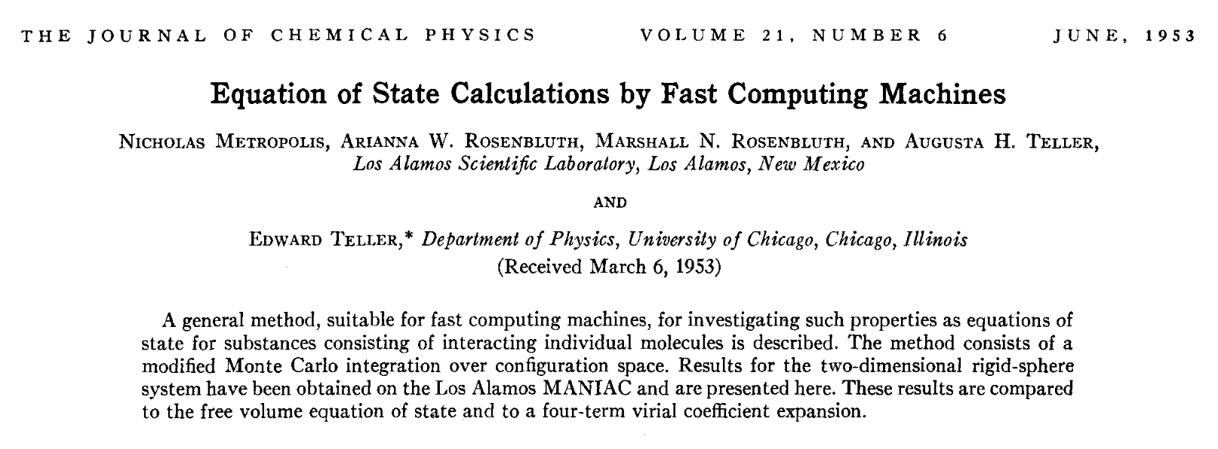
Metropolis Hastings Algo 1953

Slide 15
MCMC en pratique
https://www.quantstart.com/articles/Markov-Chain-Monte-Carlo-for-Bayesian-Inference-The-Metropolis-Algorithm
The main difference between MCMC algorithms occurs in how you jump as well as how you decide whether to jump.
The Metropolis algorithm uses a normal distribution to propose a jump. This normal distribution has a mean value μ which is equal to the current position and takes a "proposal width" for its standard deviation σ.
proposal width :
larger => more exploration,
smaller takes longer to converge, might miss whole regions
Metropolis Algorithm
Begin the algorithm at the current position in parameter space (θcurrent)
Propose a "jump" to a new position in parameter space (θnew)
Accept or reject the jump probabilistically using the prior information and available data
If the jump is accepted, move to the new position and return to step 1
If the jump is rejected, stay where you are and return to step 1
After a set number of jumps have occurred, return all of the accepted positions => trace

Slide 16
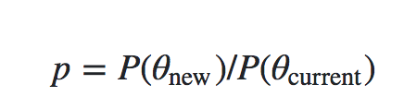
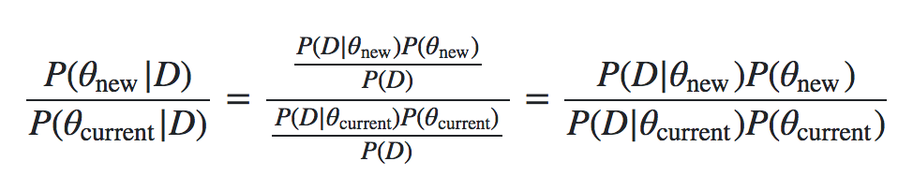
Acception criteria
Calculate ratio of probability current point vs probability previous point => p
Generate random number a in [0,1]
if a < p => accept else reject
depends only on the likelihoods and the priors
no longer on P(D)

Slide 17
MCMC Implementation
see http://twiecki.github.io/blog/2015/11/10/mcmc-sampling/
and https://github.com/twiecki/WhileMyMCMCGentlySamples/blob/master/content/downloads/notebooks/MCMC-sampling-for-dummies.ipynb
the trace (list of all accepted samples)
Look at autocorrelation to see of the samples are correlated
small jump size: large autocorr
need for a burn-in period to reduce influence of start area

Slide 18
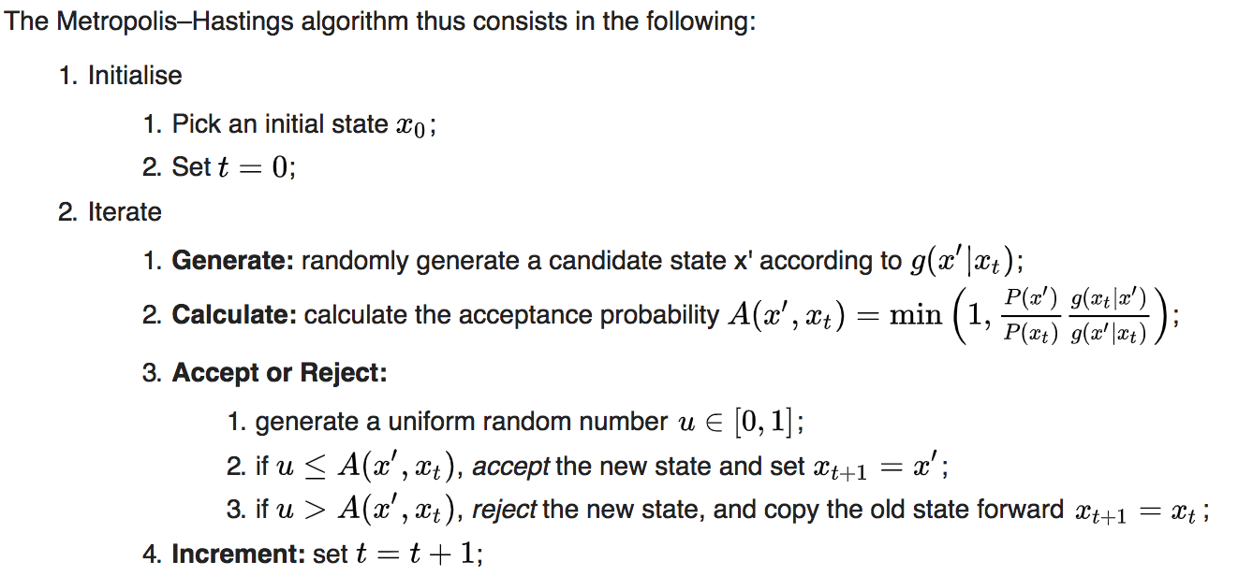
Markov Chains
Demo: Markov chain
http://setosa.io/ev/markov-chains/
Good equations in MCMC_app.pdf

Slide 19
MCMC en theorie
voir page wikipedia
et https://jeremykun.com/2015/04/06/markov-chain-monte-carlo-without-all-the-bullshit/
* stationary distribution theorem (sometimes called the “Fundamental Theorem of Markov Chains,” and for good reason).
* for a very long random walk, the probability that you end at some vertex v is independent of where you started!
* the stationary distribution is a probability distribution \pi such that A \pi = \pi, in other words \pi is an eigenvector of A with eigenvalue 1.
* the problem we’re trying to solve is to draw from a distribution over a finite set X with probability function p(x).
* The MCMC method is to construct a Markov chain whose stationary distribution is exactly p
* Now we have to describe the transition probabilities. Let r be the maximum degree of a vertex in this lattice (r=2d). Suppose we’re at vertex i and we want to know where to go next. We do the following:
* Pick neighbor j with probability 1/r (there is some chance to stay at i).
* If you picked neighbor j and p(j) \geq p(i) then deterministically go to j.
* Otherwise, p(j) < p(i), and you go to j with probability p(j) / p(i).
* We can state the probability weight p_{i,j} on edge (i,j) more compactly as
\displaystyle p_{i,j} = \frac1r \min(1, p(j) / p(i)) \\ p_{i,i} = 1 - \sum_{(i,j) \in E(G); j \neq i} p_{i,j}

Slide 20
Why does Metropolis-Hastings work?
http://people.duke.edu/~ccc14/sta-663-bootstrap/MCMC.html#why-does-metropolis-hastings-work

Slide 21
MCMC by Christopher Fonnesbeck
Christopher Fonnesbeck Probabilistic Programming with PyMC3 PyCon 2017
https://youtu.be/5TyvJ6jXHYE?t=1012

Slide 22
Bayesian Linear regression

Slide 23
Freq vs Bayes
OLS regression
Probability of obtaining the data in hand if the null hypothesis was true: p(D|Ho)
Unfortunately, p(Ho|D) != p(D|Ho)
"a test of statistical significance "does not tell us what we want to know, and we so much want to know what we want to know that, out of desperation, we nevertheless believe that it does!" Cohen, J. (1994). The earth is round (p < 0.05). American Psychologist, 49, 997-1003.

Slide 24
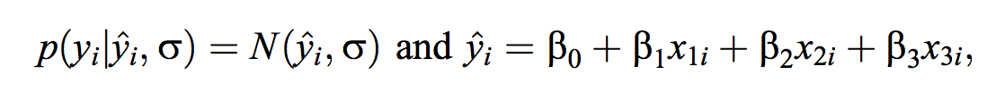
likelihood
probability of observed data values given any candidate values
of the parameters and thereby constitutes the likelihood function in Bayes’ rule

Slide 25
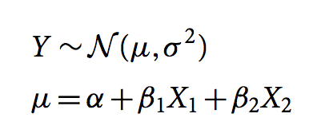
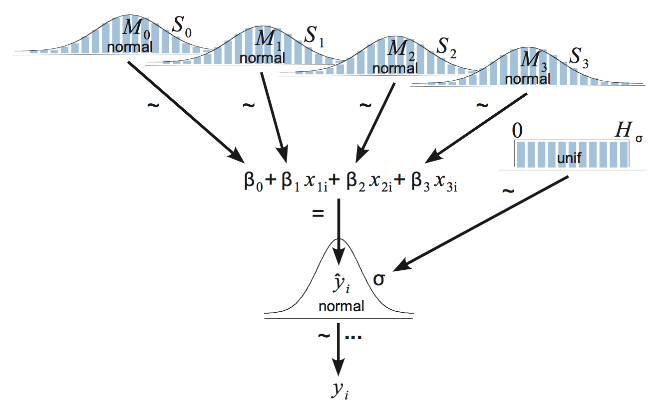
see linear_regression.py

Slide 26
Application to Ozone
Linear regression

Slide 27
Ozone dataset
Temp = f(Ozone, Wind, Solar)
Temp = a + b * Ozone + e
Temp ~ N(mu, sigma)
mu ~ N(0,10), sigma ~ HalfN(0,1)
Statsmodel OLS
2 predictors Temp = f(Ozone, Wind)
normalize, diff coef
Use Student-t to model Temp
glm model in PyMC3

Slide 28
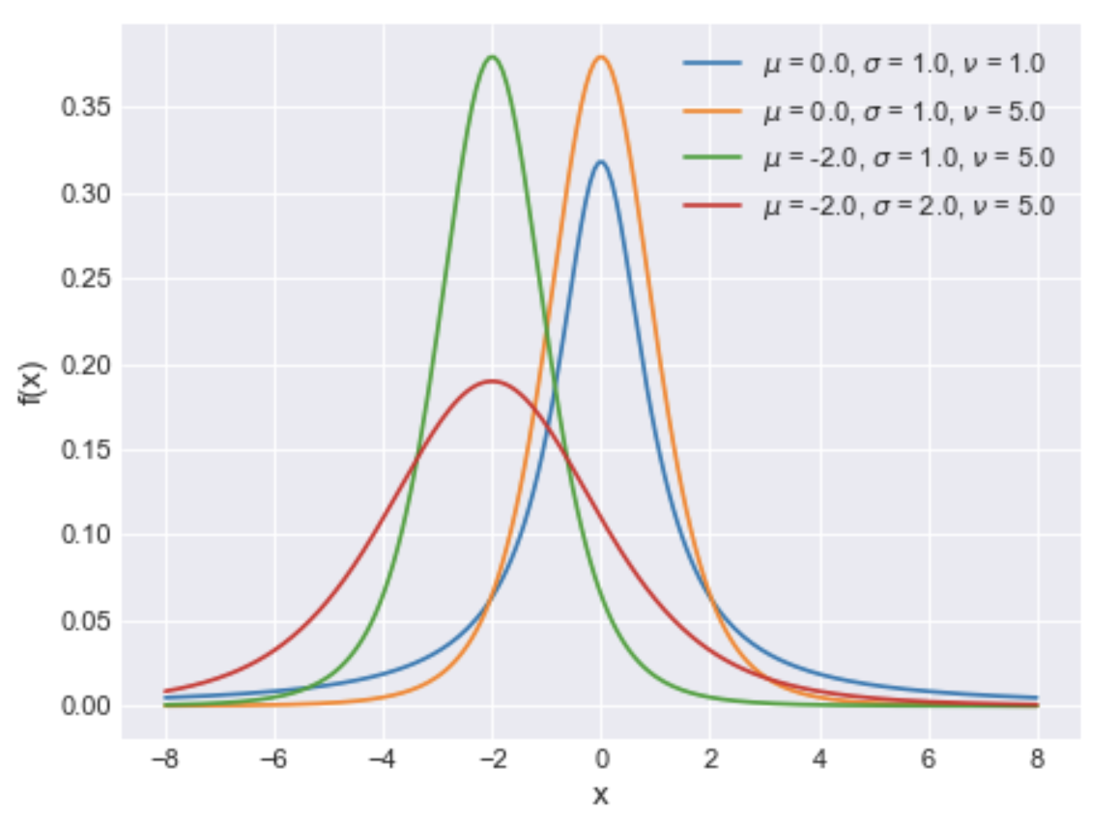
Student-T distribution
https://docs.pymc.io/api/distributions/continuous.html#pymc3.distributions.continuous.StudentT
 | nu : float Degrees of freedom, also known as normality parameter (nu > 0). mu : float Location parameter. sd : float Scale parameter (sd > 0). Converges to the standard deviation as nu increases. (only required if lam is not specified)

Slide 29
Logistic regression
Iris?

Slide 30
Predict
how to
AUC, RMSE?

Slide 31
Optimize
MAP, posterior predictive checks

Slide 32
pymc3.plots
forest plot, posteriori plot, …

Slide 33
Model Comparison
# Model comparison
https://pymc3.readthedocs.io/en/stable/notebooks/model_comparison.html

Slide 34
Model debugging
# How to debug a model
https://github.com/pymc-devs/pymc3/blob/master/docs/source/notebooks/howto_debugging.ipynb

Slide 35
WAIC – comparison, model selection
pm.stats.waic(model=models_lin['k1'], trace=traces_lin['k1'])
We should prefer the model(s) with lower WAIC
Watanabe - Akaike Information Criterion (WAIC) is another simple option for calculating the goodness-of-fit of amodel
https://docs.pymc.io/api/stats.html
pm.stats.loo(trace_t, model_t)
Compare

Slide 36
Maximum a posteriori methods
The maximum a posteriori (MAP) estimate for a model, is the mode of the posterior distribution and is generally found using numerical optimization methods. This is often fast and easy to do, but only gives a point estimate for the parameters and can be misleading if the mode isn’t representative of the distribution. PyMC3 provides this functionality with the find_MAP function.
Below we find the MAP for our original model. The MAP is returned as a parameter point, which is always represented by a Python dictionary of variable names to NumPy arrays of parameter values.
from pymc3 import find_MAP map_estimate = find_MAP(model=basic_model) print(map_estimate) {‘alpha’: array(1.0136638069892534), ‘beta’: array([ 1.46791629, 0.29358326]), ‘sigma_log’: array(0.11928770010017063)}
find_MAP uses the Broyden–Fletcher–Goldfarb–Shanno (BFGS) optimization algorithm to find the maximum of the log-posterior
the MAP estimate is not always reasonable, especially if the mode is at an extreme.
This can be a subtle issue; with high dimensional posteriors, one can have areas of extremely high density but low total probability because the volume is very small.

Slide 37
Posterior Predictive Checks
https://docs.pymc.io/notebooks/posterior_predictive.html
Samples N from trace => mu, sigma
Then draw M samples from Normal distribution generated by those parameters

Slide 38
Sampler stats
When checking for convergence or when debugging a badly behaving sampler, it is often helpful to take a closer look at what the sampler is doing. For this purpose some samplers export statistics for each generated sample.
https://pymc3.readthedocs.io/en/stable/notebooks/sampler-stats.html

Slide 39
GLM

Slide 40
Generalized Linear Models
https://docs.pymc.io/notebooks/getting_started#Generalized-Linear-Models
API is failing
check # Alternative formulation using GLM formulas¶
http://people.duke.edu/~ccc14/sta-663-bootstrap/PyMC3.html#alternative-fromulation-using-glm-formulas
https://docs.pymc.io/notebooks/GLM-robust-with-outlier-detection.html#Create-Robust-Model:-Student-T-Method

Slide 41
Ordinary Least Squares Regression with PyMC3 in https://blog.applied.ai/bayesian-inference-with-pymc3-part-1/

Slide 42
TD
Grades or car emissions

Slide 43
https://blog.applied.ai/bayesian-inference-with-pymc3-part-2/

Slide 44
https://towardsdatascience.com/bayesian-linear-regression-in-python-using-machine-learning-to-predict-student-grades-part-2-b72059a8ac7e

Slide 45
Further reading
# Further reading
A Beginner's Guide to Markov Chain Monte Carlo, Machine Learning & Markov Blankets
https://skymind.ai/wiki/markov-chain-monte-carlo
A Zero-Math Introduction to Markov Chain Monte Carlo Methods
https://towardsdatascience.com/a-zero-math-introduction-to-markov-chain-monte-carlo-methods-dcba889e0c50
# Good QA on SO
Bayesian logit model - intuitive explanation?
https://stats.stackexchange.com/questions/163034/bayesian-logit-model-intuitive-explanation
Bayes regression: how is it done in comparison to standard regression?
https://stats.stackexchange.com/questions/252577/bayes-regression-how-is-it-done-in-comparison-to-standard-regression

